Slide 1

Market Share Analysis & Competitive Positioning
A comprehensive analysis of Tredence's market position, competitive differentiation, and customer engagement strategies in the data analytics services landscape.

Slide 2
Market Share Analysis
Market Share Limitations
Direct market share data for individual vendors in the data analytics services market is not publicly available through traditional sources. However, market analysis reveals:
Estimated Positioning
Global Data Analytics Market Context (2024):
Total addressable market: $69.5 billion globally
Tredence estimated share: ~1.1-1.2% (based on $794.7M revenue)
Evalueserve estimated share: ~1.3-1.4% (based on $928.5M revenue)

Slide 3
Specialist Analytics Services Quadrant
19
8
Qualified Providers
Leaders Identified
Total number of providers evaluated in the specialist analytics services market
42% concentration among leaders in the competitive landscape
Tredence Position
Evalueserve Position
Positioned in Leader quadrant as one of 8 leaders among 19 qualified providers
Positioned as Leader in Customer Analytics specifically per Forrester
Remaining providers distributed among Product/Market Challengers and Contenders

Slide 4

Top Market Players by Revenue
Accenture
Deloitte
$53.7 billion
Estimated $50B+
Large integrated consulting including analytics
Integrated services
Tiger Analytics
Fractal Analytics
$2.0 billion
$1.94 billion
Specialist analytics peer
Specialist analytics peer
Evalueserve
Tredence
$928.5 million
$794.7 million
Mu Sigma: $784.6 million (specialist analytics peer)

Slide 5
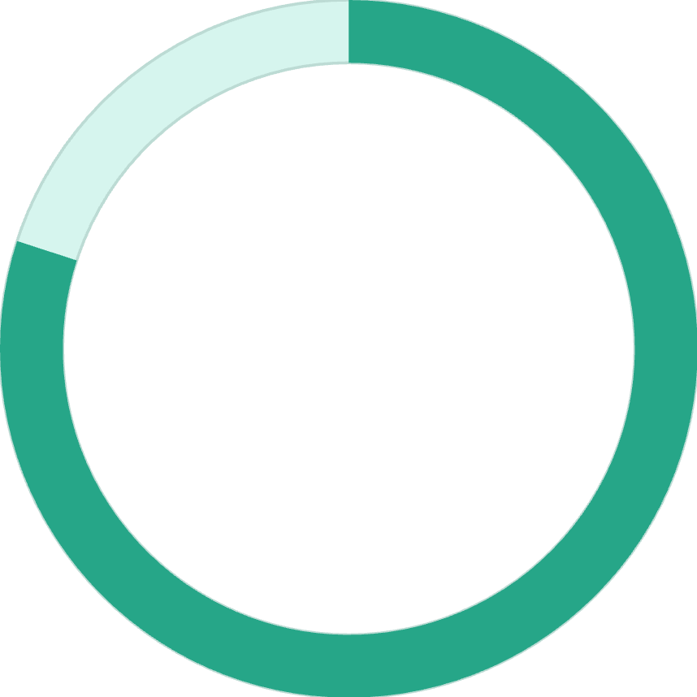

CPG/Retail Vertical Market Share
Within high-value retail vertical, Tredence demonstrates concentrated strength:
80%
$2T+
Top Global Retailers
Revenue Partnership
Claims 8 of top 10 global retailers as clients
Represents partnership with retailers controlling $2+ trillion in revenue
Likely dominates retail analytics services market share within Top 100 retailers globally

Slide 6
Customer Engagement Strategies
Multi-Layered Engagement Model
Strategic Engagement Framework:
01
02
Foundry and Factory Delivery Model
Centers of Excellence (CoE) Establishment
Foundry Phase: Co-innovation workshops during conceptualization enabling preliminary engineering work and business case validation
Tredence partners with clients to establish dedicated analytics CoEs within client organizations
Factory Phase: Rapid deployment of production-ready solutions leveraging pre-built accelerators
Combines Tredence expertise with client domain knowledge for sustainable capability transfer
Outcome: Faster time-to-value, reduced risk, and clear phased business case validation
Ongoing advisory relationships create stickiness beyond individual projects
03
04
Outcome-Based Partnerships
Executive Engagement
NPS-driven engagement with industry-leading 94% NPS across 1,000+ projects
CEO/Co-founder engagement on strategic accounts
Executive workshops on last-mile adoption and AI transformation strategy
Performance-tied engagements where Tredence success correlates with client business outcomes
Thought leadership positioning through analyst presentations and speaking engagements
Joint investment in outcomes supports outcomes-based pricing models

Slide 7
Ongoing Relationship Models
Account Management Structure
Quarterly Business Reviews
Dedicated customer success teams assigned to major accounts
Strategic discussions on ROI realization and next use-case identification
Innovation Workshops
Training & Enablement
Regular sessions to identify new AI/analytics applications leveraging emerging technologies
Investment in client team upskilling to increase self-service and reduce dependency on Tredence
Platform-Based Engagement
Through ATOM.AI and accelerator offerings, Tredence enables:
Faster client self-service capability development
Reduced implementation timelines from years to weeks
Technology licensing models creating recurring revenue streams vs. one-time project fees
Platform communities fostering peer learning and best practice sharing
Customer Feedback Mechanisms
Systematic NPS tracking with closed-loop follow-up on detractor feedback
Customer advisory boards for strategic account input on product roadmap
Digital customer portal for issue tracking and solution access
Proactive health checks and utilization reviews on platform licenses

Slide 8

Differentiation vs. Market Competitors
Core Differentiation Strategy
Tredence differentiates through three pillars:

Slide 9

Five Key Differentiators
1. Last-Mile Adoption Philosophy
2. Vertical-First Domain Expertise
3. Speed-to-Value Through Acceleration
Unlike competitors focused on insight generation, Tredence uniquely emphasizes operationalizing insights into business value. This manifests as:
Tredence's focused approach on key verticals vs. horizontal positioning:
Proprietary accelerator ecosystem reducing traditional consulting timelines:
Retail mastery: 8 of top 10 global retailers as clients, enabling deep pattern recognition across industry leaders
50% faster deployment: ATOM.AI reduces time-to-value by 50% through pre-built models, feature stores, and architecture patterns
Embedding insights into client applications: Solutions activate insights within client production systems rather than delivering static reports
CPG depth: 6 of top 10 CPG companies, translating to battle-tested solutions for industry-specific challenges
Weeks not years: Customer Cosmos enables 360-degree customer view in weeks vs. multi-year transformations
Agentic AI focus: Reducing consultant dependency by building autonomous systems that sustain value post-engagement
Industry-specific accelerators: 140+ ATOM.AI accelerators purpose-built for retail, CPG, BFSI, healthcare rather than generic frameworks
Measurable ROI in months: First use-case typically generates 15-25% ROI improvement within 3-6 months
Outcomes measurement: Client success defined by business impact metrics (revenue uplift, cost reduction) not just technical deployment
Vertical hiring: Recruiting senior retail/CPG practitioners as customer success leads
Scalability through platforms: After first success, clients can self-deploy additional solutions across business units
White-box solutions: Transferring solutions to client ownership ensuring sustainability and adoption
Competitive Advantage: Depth over breadth creates defensibility; competitors can acquire talent but can't instantly replicate 10+ years of customer feedback baked into vertical accelerators.
Competitive Advantage: Competitors using custom-build approaches require longer engagement cycles; Tredence's accelerators compress timelines while improving outcomes, enabling more efficient business models.
Competitive Advantage: While Fractal and Tiger Analytics provide strong data science, and Evalueserve excels in speed-to-insights, Tredence uniquely owns the "activation" layer where most value realization actually occurs.
4. Hyperscaler Partnership Depth
5. GenAI & Agentic AI Early Leadership
Strategic, exclusive partnerships providing integrated solutions:
Positioning Tredence at forefront of autonomous AI innovation:
GCP Partner of Year: Exclusive recognition vs. competitors; deep Vertex AI, BigQuery integration in Customer Cosmos
10% revenue reinvestment in R&D: Significant investment vs. industry norms
Databricks Premier Partner: 250+ certified architects, ATOM.AI built on Lakehouse, Brickbuilder solutions
Agentic AI training: 1,000+ employees trained in autonomous agents
Snowflake Center of Excellence: Migration accelerators reducing implementation by 50%
Production deployment: Agents for coding, decision-making, data analysis already in client deployments
Competitive Advantage: Partnerships not available to all competitors; exclusive solutions requiring combined capabilities difficult to replicate; reference architectures and pre-built integrations reduce time-to-value.
Future-ready talent: Building bench of specialists before market-wide demand surge
Competitive Advantage: First-mover advantage in agentic AI; when market transitions from GenAI to autonomous agents (2025-2026 timeframe), Tredence's early investment provides edge in delivery and pricing power.

Slide 10
Competitor Comparison
Differentiator
Tredence
Fractal Analytics
Tiger Analytics
Evalueserve
Last-Mile Focus
★★★★★ Proprietary
★★★ Behavioral science
★★★ Strong performer
★★ Speed focus
Vertical Depth
★★★★★ Retail/CPG
★★★★ Multi-industry
★★★★ Balanced
★★★ Diverse
Accelerators/IP
★★★★★ 140+ ATOM.AI
★★★★ Moderate
★★★ Emerging
★★ Limited
GenAI/Agents
★★★★★ Leadership
★★★★ Strong
★★★ Growing
★★★ Developing
NPS/Customer Loyalty
★★★★★ 57 NPS
★★★★ Strong
★★★★ Competitive
★★★ Solid
Revenue Efficiency
★★★★★ $314.6K/emp
★★★ $315K/emp
★★★ $314K/emp
★★ $142.8K/emp
Scale
★★★★ $794M
★★★★★ $1.94B
★★★★★ $2.0B
★★★★★ $928M
Global Presence
★★★ Expanding
★★★★★ 17 offices
★★★★ 12+ offices
★★★★ 5+ countries
Summary
Tredence has emerged as a specialist analytics leader positioned uniquely at the intersection of data science execution and last-mile business value realization. With $794.7 million in revenue and recognition as a Forrester Leader in Customer Analytics (Q2 2025) and Everest Group Leader in Data & AI Services, Tredence competes effectively despite being smaller than generalist competitors like Accenture or volume-focused peers like Evalueserve.
The company's differentiation rests on vertical domain expertise (particularly retail/CPG), accelerator-driven speed-to-value, strategic hyperscaler partnerships, and agentic AI leadership. Its superior revenue per employee ($314,600 vs. Evalueserve's $142,800) and industry-leading NPS (57) indicate strong operational efficiency and customer satisfaction despite higher perceived work intensity.
As the market shifts from insight generation to autonomous AI-driven value realization—Tredence's core focus—the company is positioned for continued premium growth, though talent retention and geographic concentration remain near-term challenges requiring strategic investment.

